Slide 1
Twitter Sentiment Analysis
Submitted By
Ms Komal Rote(2015060)
Ms Shruti Rahte(2015057)

Slide 2
A Twitter sentiment analysis is the process of determining the emotional tone behind a series of words, specifically on Twitter. A sentiment analysis tool is an automated technique that extracts meaningful customer information related to their attitudes, emotions, and opinions. A Twitter sentiment analysis identifies negative, positive, or neutral emotions within the text of a tweet. It is a text analysis using natural language processing (NLP) and machine learning. It identifies and extracts subjective information from original data, providing a company with a better understanding of the social sentiment of its brand, product, or service. Sentiment analysis is frequently used to analyze customer feedback, survey responses, and product reviews.
Introduction

Slide 3
Literature Survey
”Twitter Sentiment Analysis: The Good the Bad and the OMG!” by Saif, Fern´andez, He and Alani (2013) - This paper offers a comprehensive review of different approaches to sentiment analysis on Twitter, including lexiconbased, machine learning-based, and hybrid methods. It also discusses challenges and limitations, such as sarcasm, ambiguity, and context-dependency.
2. ”Sentiment Analysis and Opinion Mining” by Pang and Lee (2008) - This seminal paper provides an overview of sentiment analysis and opinion mining, including its history, applications, and challenges. It also proposes a framework for classification tasks and discusses different approaches, such as machine learning, lexicon-based, and rule-based methods.
3. ”Deep Learning for Sentiment Analysis: A Survey” by Zhang, Zhao, and LeCun (2018) - This survey paper focuses on the use of deep learning techniques, such as neural networks and convolutional neural networks (CNNs), for sentiment analysis on Twitter. It discusses different models and architectures, such as LSTM, GRU, and attention mechanisms, and their performance compared to traditional methods.

Slide 4
4. ”Twitter Sentiment Analysis: A Comparative Study of Preprocessing Techniques” by Malik and Singh (2020) - This paper compares the performance of different pre-processing techniques, such as stemming, stop word removal, and feature extraction, on Twitter sentiment analysis using machine learning algorithms. The authors also discuss the impact of data imbalance and selection bias on the results.
5. ”Sentiment Analysis of Twitter Data: A Comparative Study of Feature Selection Methods” by Kumar, Pandey, and Pal (2018) - This paper compares the performance of different feature selection methods, such as TF-IDF, Chi-squared, and Mutual Information, on sentiment analysis of Twitter data using machine learning algorithms. The authors also discuss the impact of different feature dimensions and classifiers on the results.
6. Sharma et al proposed an unsupervised document-based sentiment analysis system able to determine the sentiment orientation of text documents based on their polarities. This system categorizes documents as positive and negative [2, 3, 19] and extracts sentiment words from document collections, classifying them according to their polarities.

Slide 5
Problem Statement
A basic task in sentiment analysis is classifying the polarity of a given text at the document, sentence, or feature/aspect level — whether the expressed opinion in a document, a sentence or an entity feature/aspect is positive, negative, or neutral. Advanced, “beyond polarity” sentiment classification looks, for instance, at emotional states such as “angry”, “sad”, and “happy”. And basically that’s what we need.
For example, given a service feedback “I’ve used your product XXX and I haven’t been disappointed, only the opposite!” we need to understand, that this client, and, maybe, thousands of others are satisfied with product XXX. Unfortunately, lot of rule-based or keyword extraction models for sentiment analysis will not find in this sentence any word as “happy”, “lucky”, “good” and may pay attention to “disappointed” or “haven’t”, which can lead to misclassification of this sentence to neutral or even negative tone. Modern machine learning solutions will help us to avoid these and others problems

Slide 6
Proposed System
The Proposed solution is an Web Application, “Machine Learning Analytics With Twitter Data On Sentiment Analysis” Which is used to performing Sentiment Analysis on Twitter is trickier than doing it for large reviews. Overall, this proposed system for Twitter sentiment analysis can help businesses and organizations to gain insights into the public opinion about their brand, products or services on Twitter.
They can use this information to improve their customer experience, product design, and marketing strategy. This is because the tweets are very short (only about 140 characters) and usually contain slangs, emoticons, hash tags and other twitter specific jargon. It is developed on web based platform so it can be used easily and anywhere with the use of internet on any your laptop, personal computer, or on your cell phone.
The user interface is very easy to understand and uses that it could be used by individuals of all ages.
Naive Bayes is a probabilistic algorithm that works well for text classification problems like sentiment analysis. It assumes independence between features, and uses the Bayes Theorem to calculate the probability of a particular sentiment given the occurrence of words in a tweet.

Slide 7
Workflow We follow these 3 major steps in our program: 1.Authorize twitter API client. 2.Make a GET request to Twitter API to fetch tweets for a particular query. 3.Parse the tweets. Classify each tweet as positive, negative or neutral TextBlob : Textblob is the python library for processing textual data. First we call clean_tweet method to remove links, special characters, etc. from the tweet using some simple regex. Then, as we pass tweet to create a TextBlob object, following processing is done over text by textblob library: i. Tokenize the tweet ,i.e split words from body of text. Ii. Remove stopwords from the tokens.(stopwords are the commonly used words which are irrelevant in text analysis like I, am, you, are, etc.) iii. Do POS( part of speech) tagging of the tokens and select only significant features/tokens like adjectives, adverbs, etc. Pass the tokens to a sentiment classifier which classifies the tweet sentiment as positive, negative or neutral by assigning it a polarity between -1.0 to 1.0 . iv. TextBlob uses a Movies Reviews dataset in which reviews have already been labelled as positive or negative. Positive and negative features are extracted from each positive and negative review respectively. Training data now consists of labelled positive and negative features. This data is trained on a Naive Bayes Classifier.

Slide 8
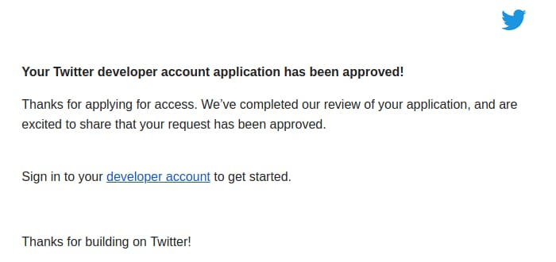
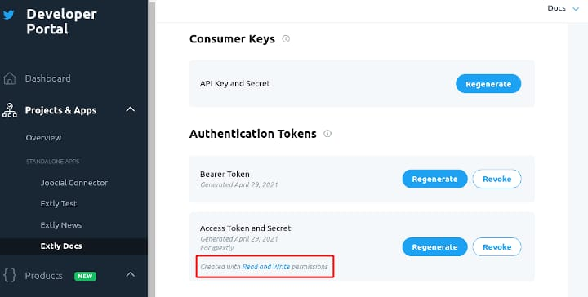
Implementation
Account of Twitter developer to Retrive the data

Slide 9
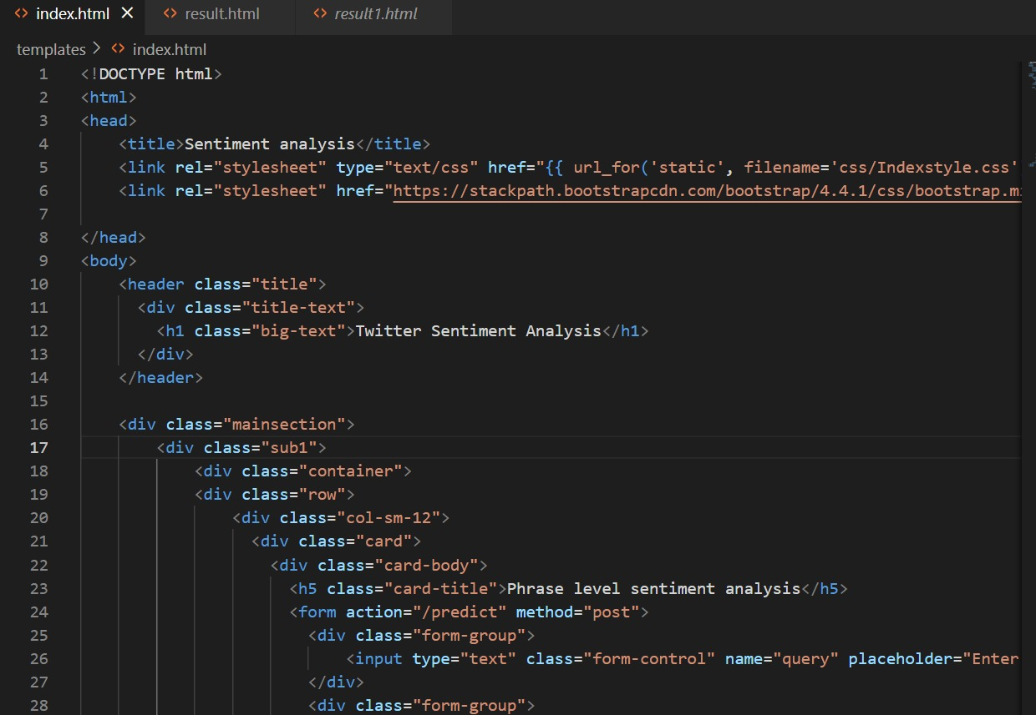
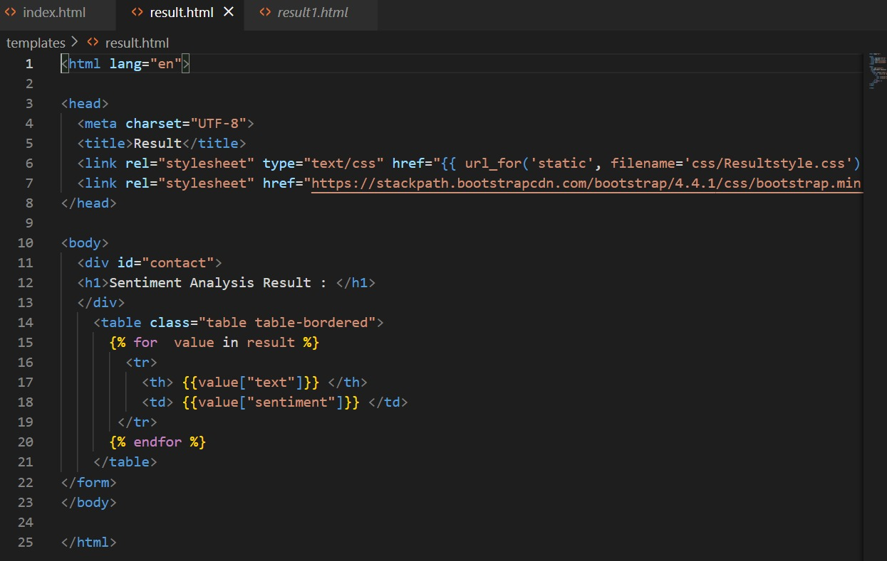
Frontend Html Code

Slide 10
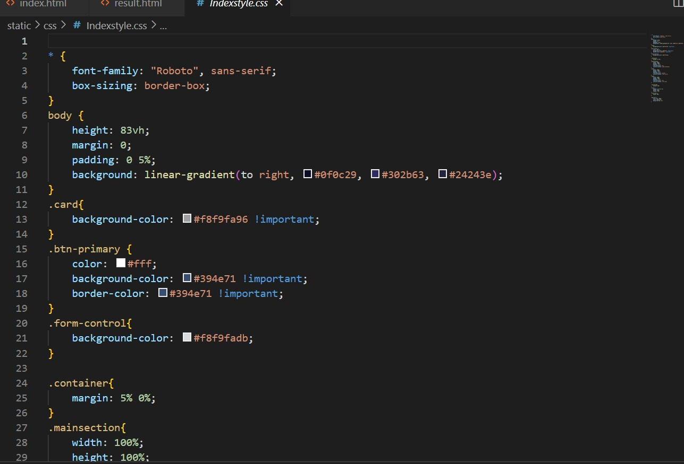
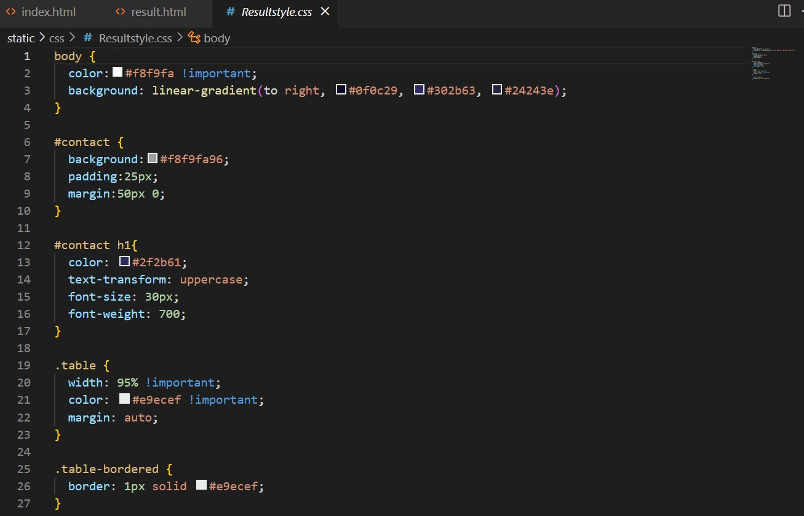
Frontend CSS Code

Slide 11
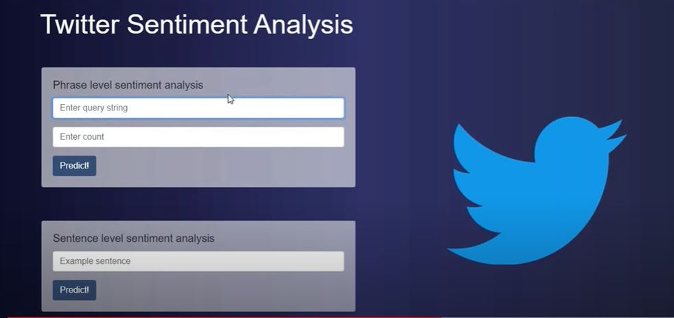
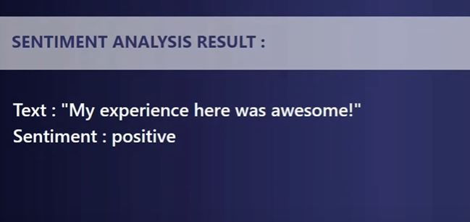
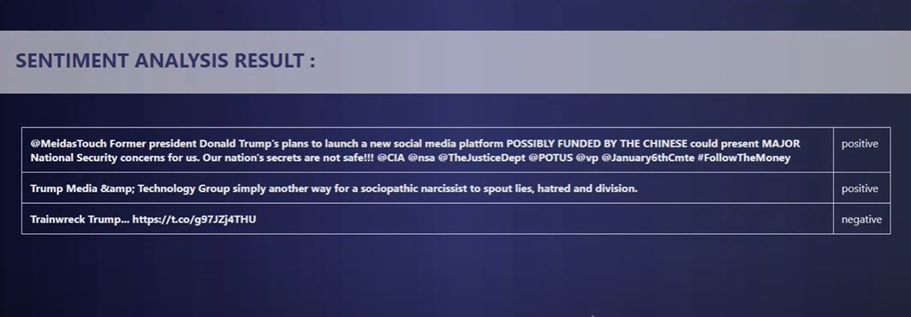
Outputs

Slide 12
Methodology
Data Collection: Collect the data from Twitter by using the Twitter API or a public dataset.
Feature Extraction : For sentiment classification, the features are mostly the terms or phrases that influence the sentiment of text. The filtered dataset post preprocessing has a lot of distinctive properties. The feature extraction method extracts the part-ofspeech from the dataset. The module contains a part-ofspeech tagger for English (identifies adjectives, verbs, and so on.). The broad classification of word classes can be done into open or closed.
Sentiment Analysis: In this module, the classification approach followed is similar to objectivity classification, which deals with classifying a tweet or a phrase as either objective or subjective. Once this is done, we check for polarity (only on the tweets that are classified as subjective by the objectivity classification) to find whether the tweet is positive, negative, or both (some researchers include both category and some don’t).
Training: Use the Naive Bayes algorithm to train a model on the training set. The algorithm calculates the probability of each feature given each class label, and the prior probability of each class label.
Deployment: Deploy the model as an API for real-time predictions or integrate it into a web application.

Slide 13
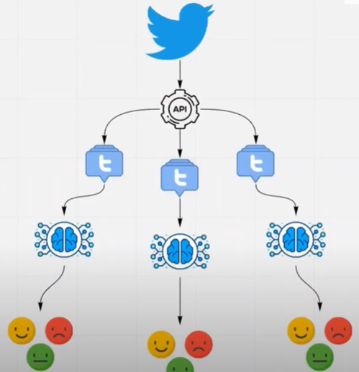
Methodology

Slide 14
Applications
Social Media Monitoring
Brand monitoring and reputation management
Product Analysis
Market Research
Market Research And Competitive research

Slide 15
Software requirements
Operating System Windows 10
Visual Studio code
Twitter Developer Account
Python
HTML and CSS
Tweepy library

Slide 16
Conclusion
Twitter Sentimental Analysis helps us preprocess the data (tweets) using different methods and feed it into ML models to give the best accuracy.
Twitter Sentimental Analysis is used to identify as well as classify the sentiments that are expressed in the text source.
A task in sentiment analysis is classifying the polarity of a given text at the document, sentence, or feature/aspect level — whether the expressed opinion in a document, a sentence or an entity feature/aspect is positive, negative, or neutral. Advanced, “beyond polarity” sentiment classification looks, for instance, at emotional states such as “angry”, “sad”, and “happy.
Naive Bayes is some of the ML algorithms that can be used for Twitter Sentimental Analysis.

Slide 17
Future Scope
The future of sentiment analysis is going to continue to dig deeper, far past the surface of the number of likes, comments and shares, and aim to reach, and truly understand, the significance of social media interactions and what they tell us about the consumers behind the screens.
Sentiment analysis can help companies understand how customers feel about a brand: positive, negative, or neutral. Brand monitoring, including sentiment analysis, is one of the most important ways to keep customers engaged and interested.
Sentiment analysis is a uniquely powerful tool for businesses that are looking to measure attitudes, feelings and emotions regarding their brand. To date, the majority of sentiment analysis projects have been conducted almost exclusively by companies and brands through the use of social media data, survey responses and other hubs of user-generated content. By investigating and analyzing customer sentiments, these brands are able to get an inside look at consumer behaviors and, ultimately, better serve their audiences with the products, services and experiences they offer.

Slide 18
References
Efthymios Kouloumpis and Johanna Moore,IJCSI International Journal of Computer Science Issues, Vol. 9, Issue 4, No 3, July 2012.
S. Batra and D. Rao, ”Entity Based Sentiment Analysis on Twitter”, Stan- ford University,2010
Saif M.Mohammad and Xiaodan zhu ,Sentiment Analysis on of social media texts:,2014
Ekaterina kochmar,University of Cambridge,at the Cambridge coding Academy Data Science.2016
Manju Venugopalan and Deepa Gupta ,Exploring Sentiment Analysis on Twitter Data, IEEE 2015
Brett Duncan and Yanqing Zhang, Neural Networks for Sentiment Analysis on Twitter.2017
Afroze Ibrahim Baqapuri, Twitter Sentiment Analysis: The Good the Bad and the OMG!,
Proceedings of the Fifth International AAAI Conference on Weblogs and Social Media.2011 26

Slide 19
Thank You

